Slide 1
Part (f)

Slide 2
Remarks
At times, a non-dimensionalized version of the prior code will be utilized instead of code developed in (e).
The main questions we are considering are:
  How can we change C_{OPA}, and C_{SHG} to modify relevant dynamics? How precisely can we do so (check FFT)?
  How does this technique work for relevant parameters?
  How does the domain size of the signum function affect the effectiveness of QPM? How can we ensure our system is experimentally permissible?

Slide 3
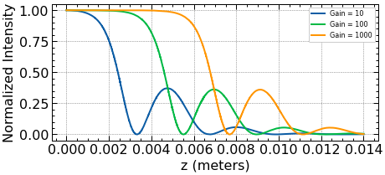
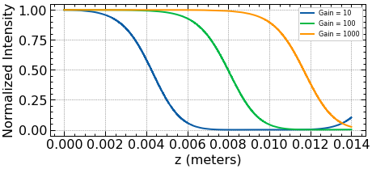
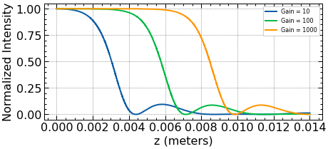
Utilizing Norton and Sterke’s QPM method to favor OPA or SHG:
Results from Flemens, Moses [1] can be reproduced without changing relevant parameters, but by changing coefficients/weights of QPM (Norton and Sterke [2]).

Slide 4
Remarks:
- γ_{inf} = ~1 (ω_{p} = ω_{2i}, ω_{s} = ω_{i}; n values are ~equal). See pdf below for derivation of γ.
- The norm squared of the Fourier transform for each d_{eff} will be graphed for analysis, as well as the argument of the signum function for reference (both sine terms).

Slide 5
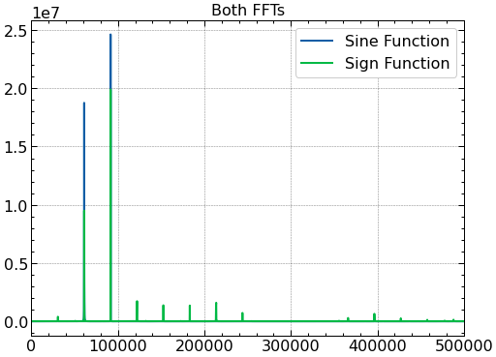
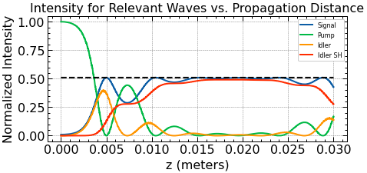
Control:
(Control intensity plot. C_{OPA} = C_{SHG} = 1)
(We have Δk_OPA = ~90000, Δk_SHG = ~60000. Ratio of sign is 1.45. Ratio of sines is 1.15)

Slide 6
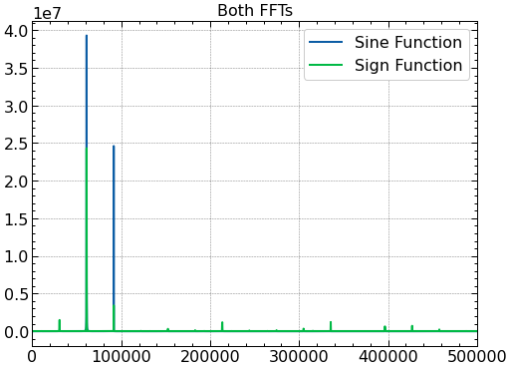
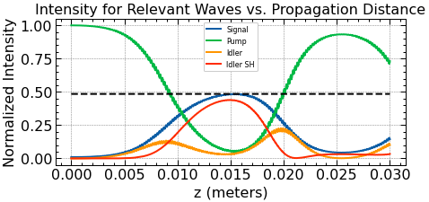
CSHG = 1.4474125441457693:
(Increasing C_{SHG} dampens the original graph. Closer to critical damping, so behavior is achieved over a shorter distance.)
(The C_{SHG} value was chosen on an attempt to make the sign ratio of the control equal to 1. Actual sign ratio is 0.37515981162288653. Sine ratio is 0.7913334944723578)

Slide 7
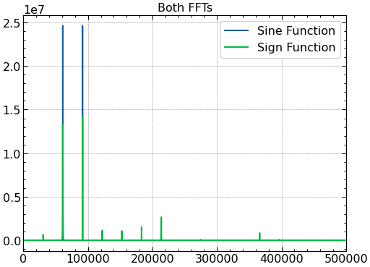
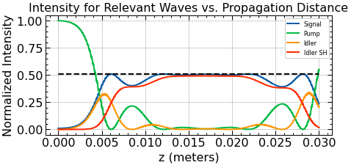
CSHG = 1.14594112177818
(C_{SHG} was chosen to make the sine ratio 1. Seems to have been effective. Both the sign and sine ratios are close to 1)

Slide 8
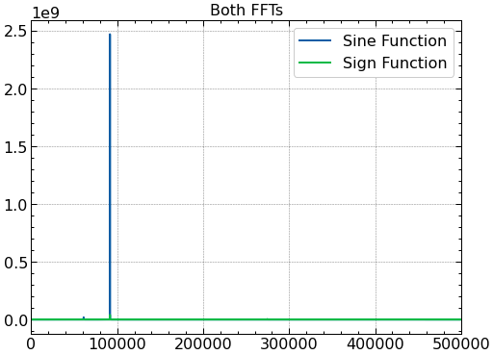
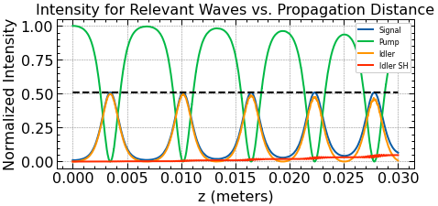
C_OPA = 10 (Heavily underdamped)
(Clearly underdamped plot)
(Sign ratio is 22.874837533806783, and sine ratio is 11.4810587422258)

Slide 9
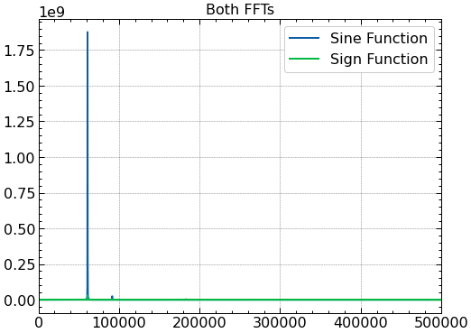
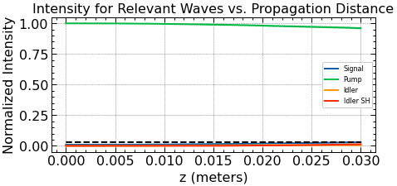
C_SHG = 10 (Heavily overdamped)
(Sign ratio is 0.05530731993373932, sine ratio is 0.1135535460869847)

Slide 10
Observations:
One should adjust the weighing of coefficients based on results of the sine function, instead of the signum function.
It appears as if the sine and signum functions don’t differ more as one increases the weight of one coefficient. This can be seen by the second example shown: where the percent difference between the ratios of the sign and sine functions is larger than that of the fringe cases (C = 10).

Slide 11
Use of sine vs. cosine:
Phase difference between sin and cos (pi/2).
Cosine slightly shifts all domains for the sign function (next slide). Effects are noticeable at Δk close to pi/2.

Slide 12
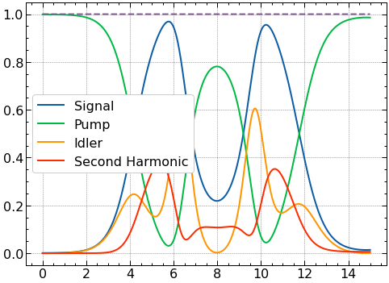
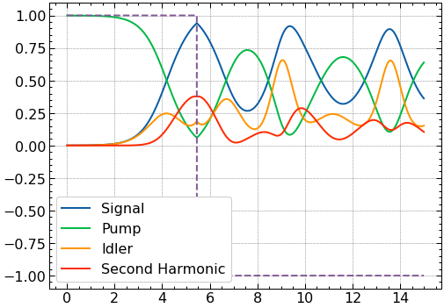
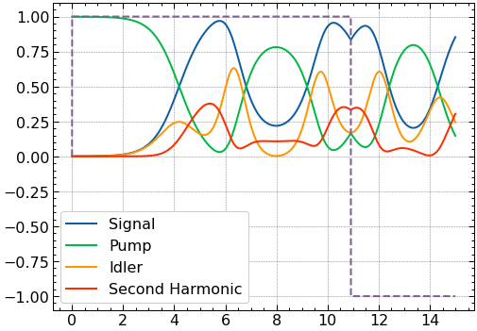
(Cos QPM matching contributes destructively)
(Sine QPM matching contributes constructively by changing from positive to negative when the function is decreasing)
(Control)

Slide 13
Damping ratio:
How does the damping depend on relevant parameters?
  -Frequencies
  -Indexes of refraction
  -Relative d_{effs}
Damping ratio can be solved for analytically:

Slide 14
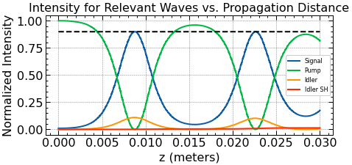
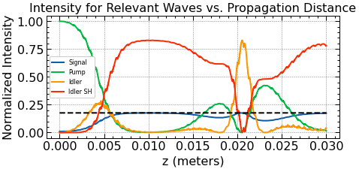
(Control)
(Increasing ω_{s} and decreasing ω_{i} leads to underdamping)
(Although graph is sketchy, it seems to indicate that increasing ω_{i} and decreasing ω_{s} leads to overdamping)

Slide 15
Δk considerations:
How does the magnitude |Δk_OPA|, and |Δk_SHG| change control of dynamics?
- Indexes of refraction will all be multiplied by 4 to increase magnitudes of Δk and keep damping ratio, and ratio of Δk’s equal.
How does the ratio |Δk_OPA|/ |Δk_SHG| change dynamics?
- Frequencies changed to change ratio, while maintaining same damping.

Slide 16
Control:

Slide 17
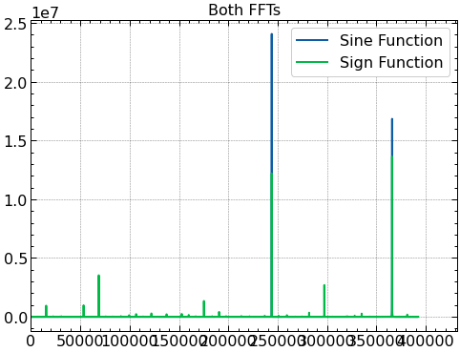
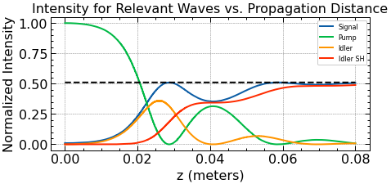
Higher Magnitude:
(Propagation needed for effects clearly increases)
(For some reason, this is the only FT to favor SHG for the sine function, but to favor OPA for the signum function)

Slide 18
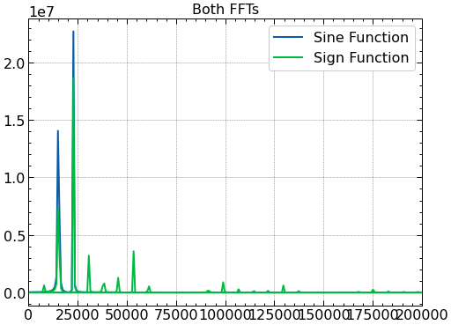
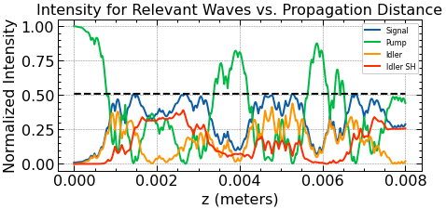
Decrease magnitude
(The graph isn’t too smooth, but it seems like the propagation distance for a cycle is lower)

Slide 19
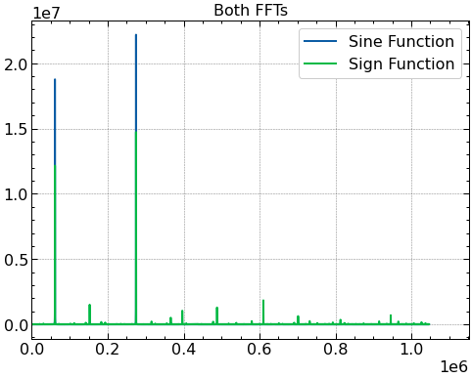
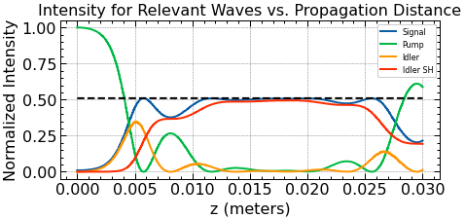
Increase ratio (4 times increase in ratio):
(More asymmetry in the plots? Seems to require less distance than control if only slightly)

Slide 20
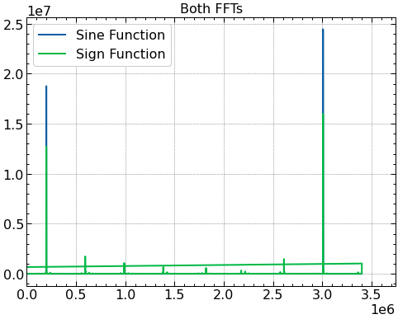
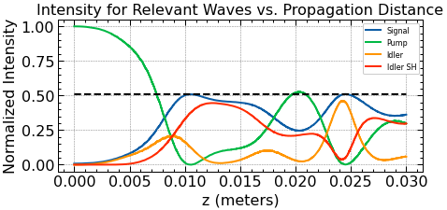
Severely increase ratio (ratio is about 50 times the control’s):
(High degree of asymmetry; more propagation required?)

Slide 21
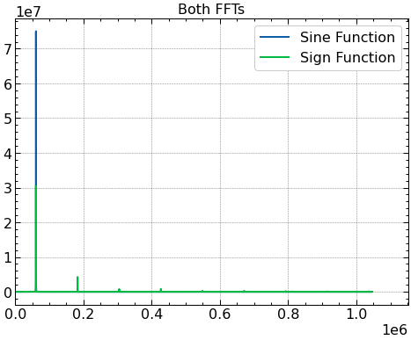
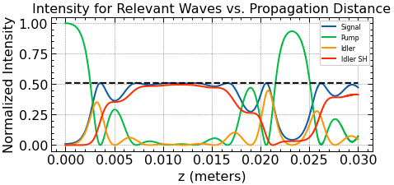
Ratio = 1
(Clearly the most efficient option; perhaps because net magnitude of phase differences is lower?)

Slide 22
Observations:
In general, increasing the magnitude of Δk’s increases propagation distance needed for full conversion.
Having both Δk’s at a 1:1 ratio is most efficient.
While there is a couple of outlier cases, in general, changing the ratio of Δk’s seems a bit uneventful, and the dynamics generally follow similarly.

Slide 23
Domain Considerations
Increasing magnitude of Δk (either Δk) generally increases net amount of jumps in signum function.
  Smallest manufacturable domain is 2.5 microns; rounding is often needed.
More jumps generally smooths curve out, and increases propagation distance required.
Increasing minimum domain size assures some rounding is needed, or that Δk’s are small in magnitude.

Slide 24
References
[1]: N. Flemens and J. Moses, "Non-Hermitian Dynamics Mimicked by a Fully Parametric Hybrid Nonlinear Optical System," in OSA Advanced Photonics Congress (AP) 2020 (IPR, NP, NOMA, Networks, PVLED, PSC, SPPCom, SOF), L. Caspani, A. Tauke-Pedretti, F. Leo, and B. Yang, eds., OSA Technical Digest (Optical Society of America, 2020), paper NpM3E.2.
[2]: Andrew H. Norton and C. Martijn de Sterke, "Aperiodic 1-dimensional structures for quasi-phase matching," Opt. Express 12, 841-846 (2004)

